Slide 1

Analysis of Brazilian E-Commerce Public Dataset
Mckinley Petalver

Slide 2
General Assumptions:
To this analysis, orders whose status is "not available" or "cancelled" are excluded, unless explicitly mentioned to the contrary.
Since the payments or other monetary-related metrics recorded in the dataset contained no indication of the currency used, I assumed it was in Brazilian Real, as Olist was specified as a Brazilian e-commerce platform.
To compare revenue or sales month-over-month or year-over-year, this report will use the "order_approved_at" dates to reflect finalized transactions. This timestamp can account for any delays in processing or cancellations and might give a more accurate picture of when the sale was confirmed.

Slide 3
Tools used:
Excel (for csv checking)
PowerBi (charting)
SQL (data storage)
Python (script for csv to sql)

Slide 4
Technical Exercise
Answers for the following questions with the appropriate visualization.

Slide 5
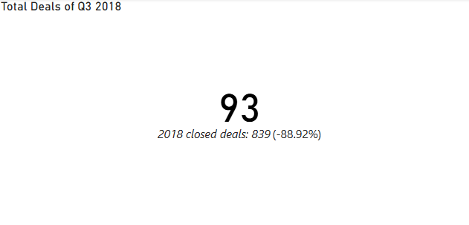
How many closed deal were won in Q3 of 2018?
Out of 842 data, 93 or 11% were closed during the third quarter of 2018.

Slide 6
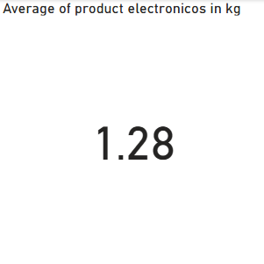
What is the average weight of ‘electronicos’ in kilograms?
1.28 kg.

Slide 7
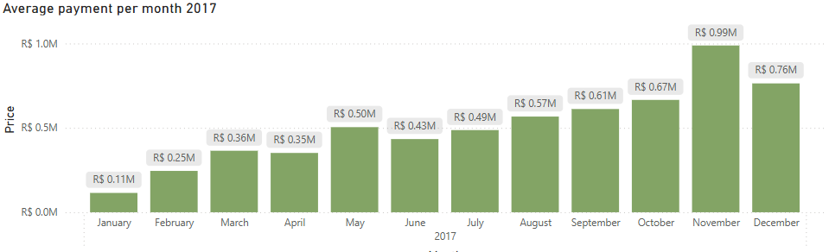
Which month in 2017 has the highest sales?
November has the highest sales based on the product revenue only in Brazilian Real.

Slide 8
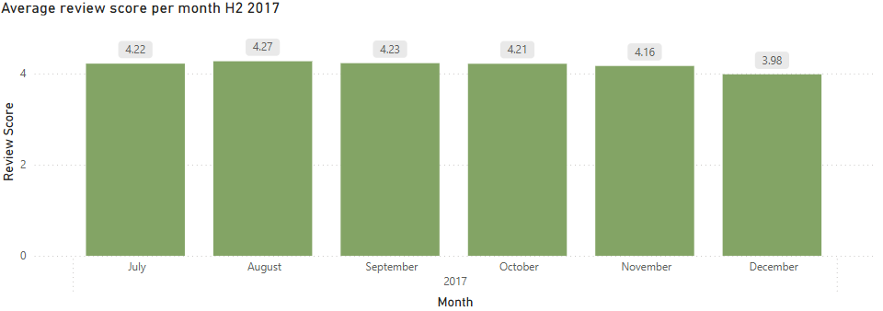
What is the average review score per month H2 2017?

Slide 9
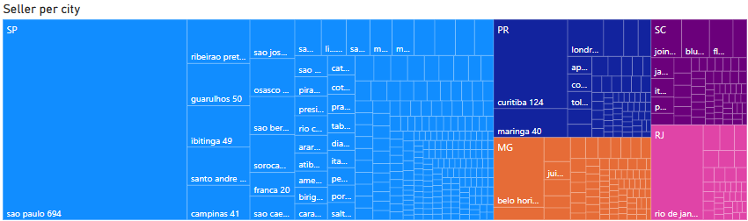
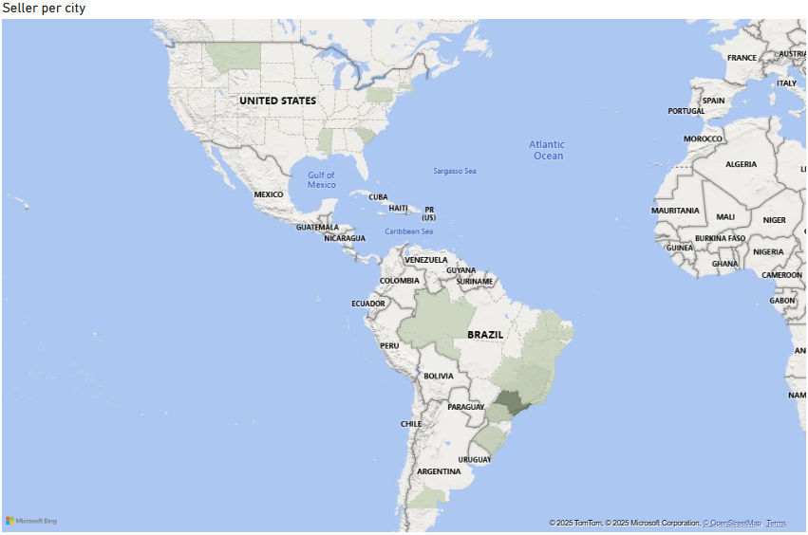
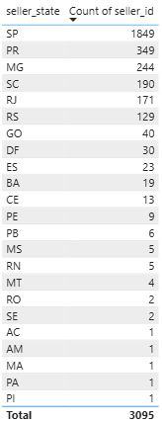
Which state has the highest number of seller per city?
SP
PR
MG
SC
RJ

Slide 10
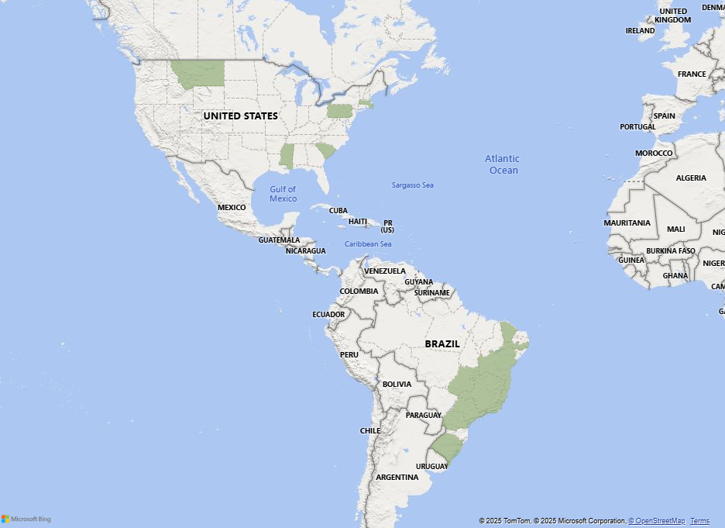
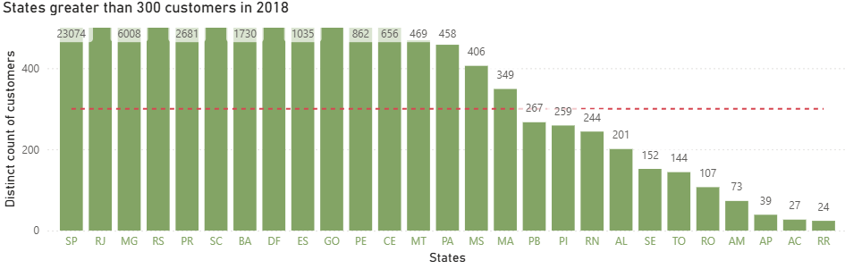
How many states have more than 300 customers in 2018?
There are 16 states which had more than 300 customers in 2018.

Slide 11
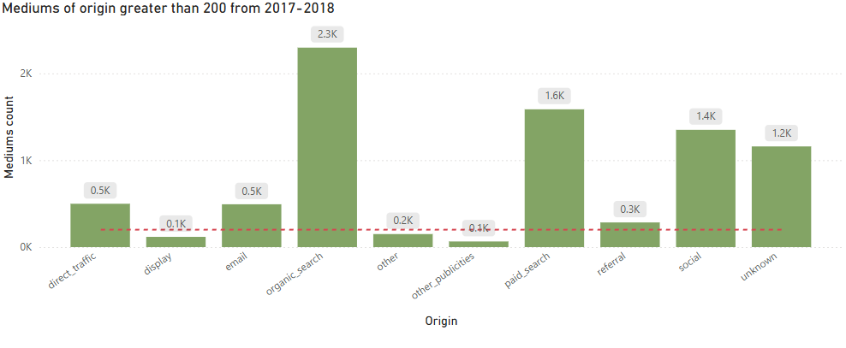
How many mediums of origin had more than 200 leads from 2017 to 2018?
There are 200 mediums of origin.
Direct traffic
Email
Organic search
Paid search
Referral
Social
Other mediums

Slide 12
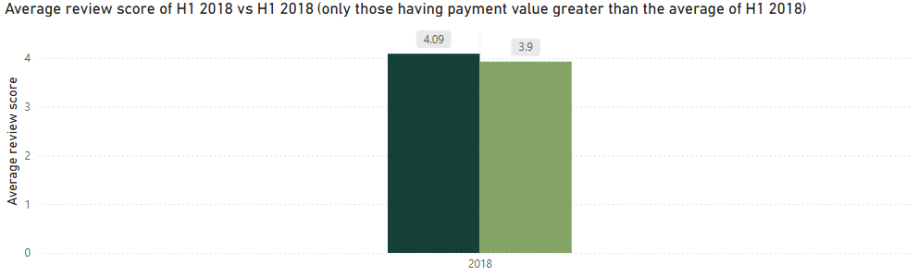
What is the average review score for orders greater than the average value in H1 of 2018?
3.9 average review score

Slide 13
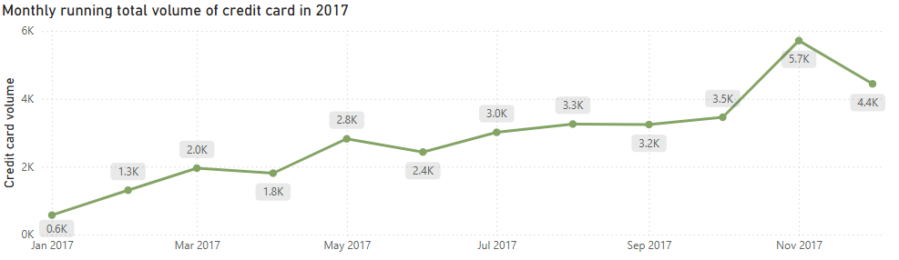
What is the monthly running total payment volume for ‘credit_card’ in 2017?

Slide 14
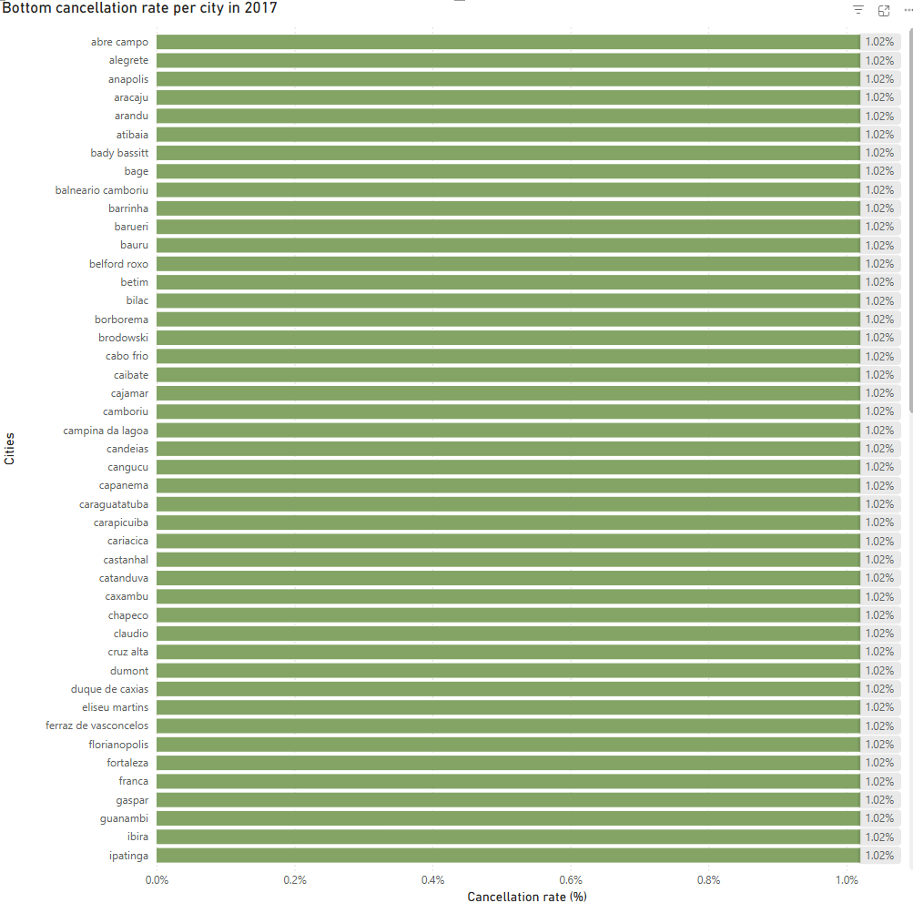
Which 3 cities have the lowest cancellation rate? What is their respective total payment volume in 2017?
There are multiple cities who had the same cancellation rate during 2017. Mostly having 1 volume per city.

Slide 15
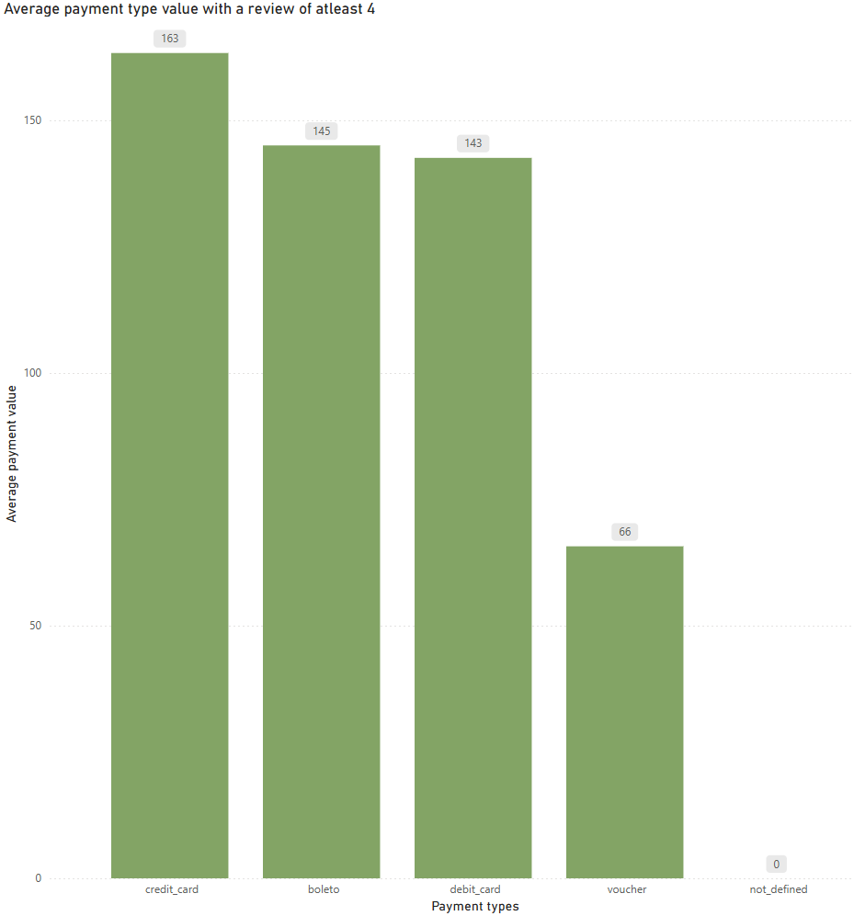
What is the average payment value per payment type for orders from sellers from Rio de Janeiro with a review score of at least 4?

Slide 16
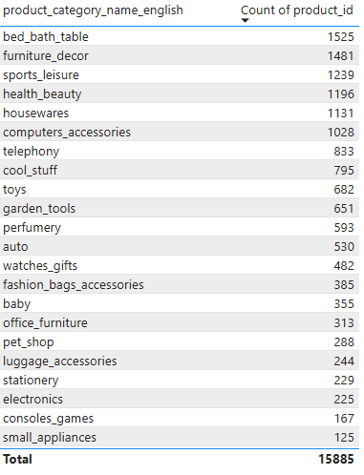
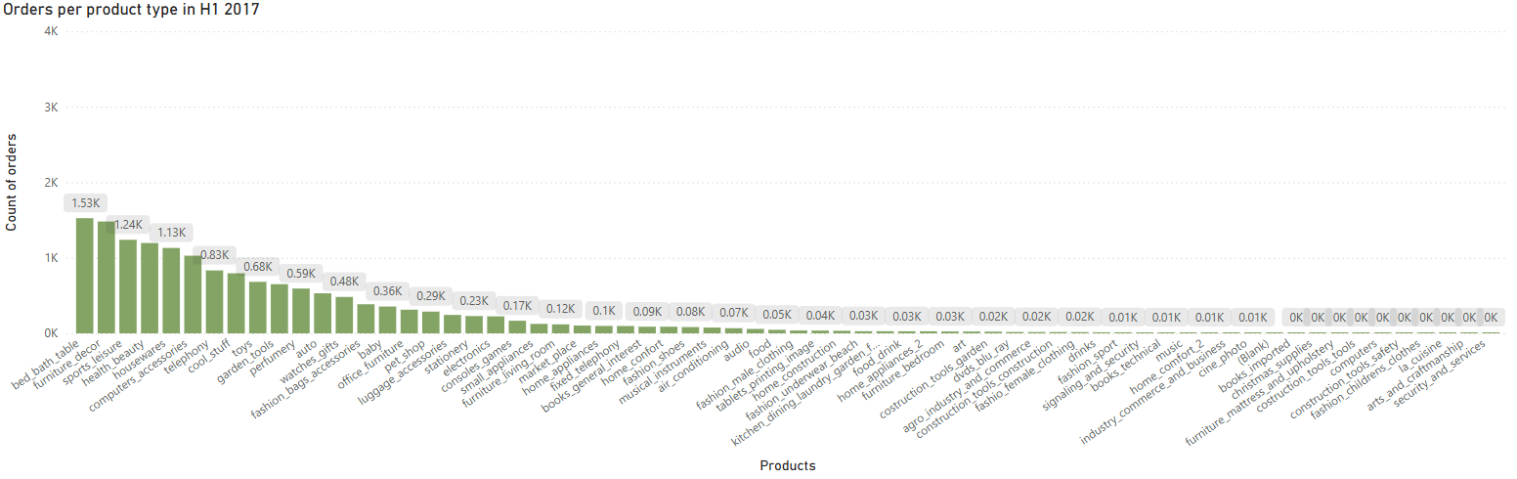
How many orders per product type in H1 2017 vs H2 2017? Show each product type in English.

Slide 17
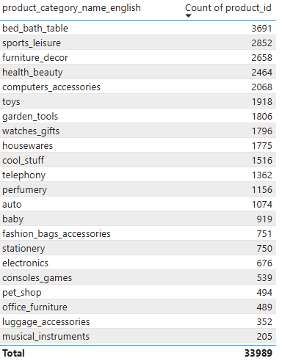
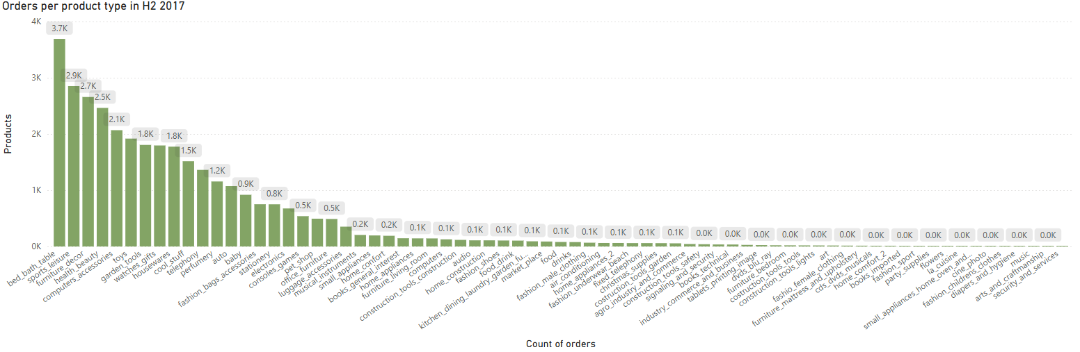
How many orders per product type in H1 2017 vs H2 2017? Show each product type in English.

Slide 18

Brazilian E-Commerce Public Dataset
The Brazilian E-Commerce Public Dataset, provided by Olist, offers a rich source of information on real-world e-commerce transactions in Brazil.
This case study aims to leverage the dataset to gain actionable insights into customer behavior, sales performance, and logistical efficiency within the Brazilian online retail landscape.

Slide 19



Report approach
Data
Acquisition
Data
Processing
Data
Analysis
After storing the cleaned and structured data in SQL using Python scripts, Power BI connected to this database through CSV files to build robust data models, establishing relationships, guided with the given ERD and creating calculated measures relevant to business questions.
Through Power BI's visualization capabilities, various charts and graphs were constructed to explore trends, patterns, and anomalies within the data, such as sales performance over time, customer segmentation, or review score performance.
By interacting with these dynamic visualizations and analyzing key performance indicators presented in Power BI, actionable insights were identified, enabling data-driven decisions regarding inventory management, marketing strategies, or customer engagement initiatives.

Slide 20
Exploratory data analysis
How did the e-commerce in Brazil performed?

Slide 21
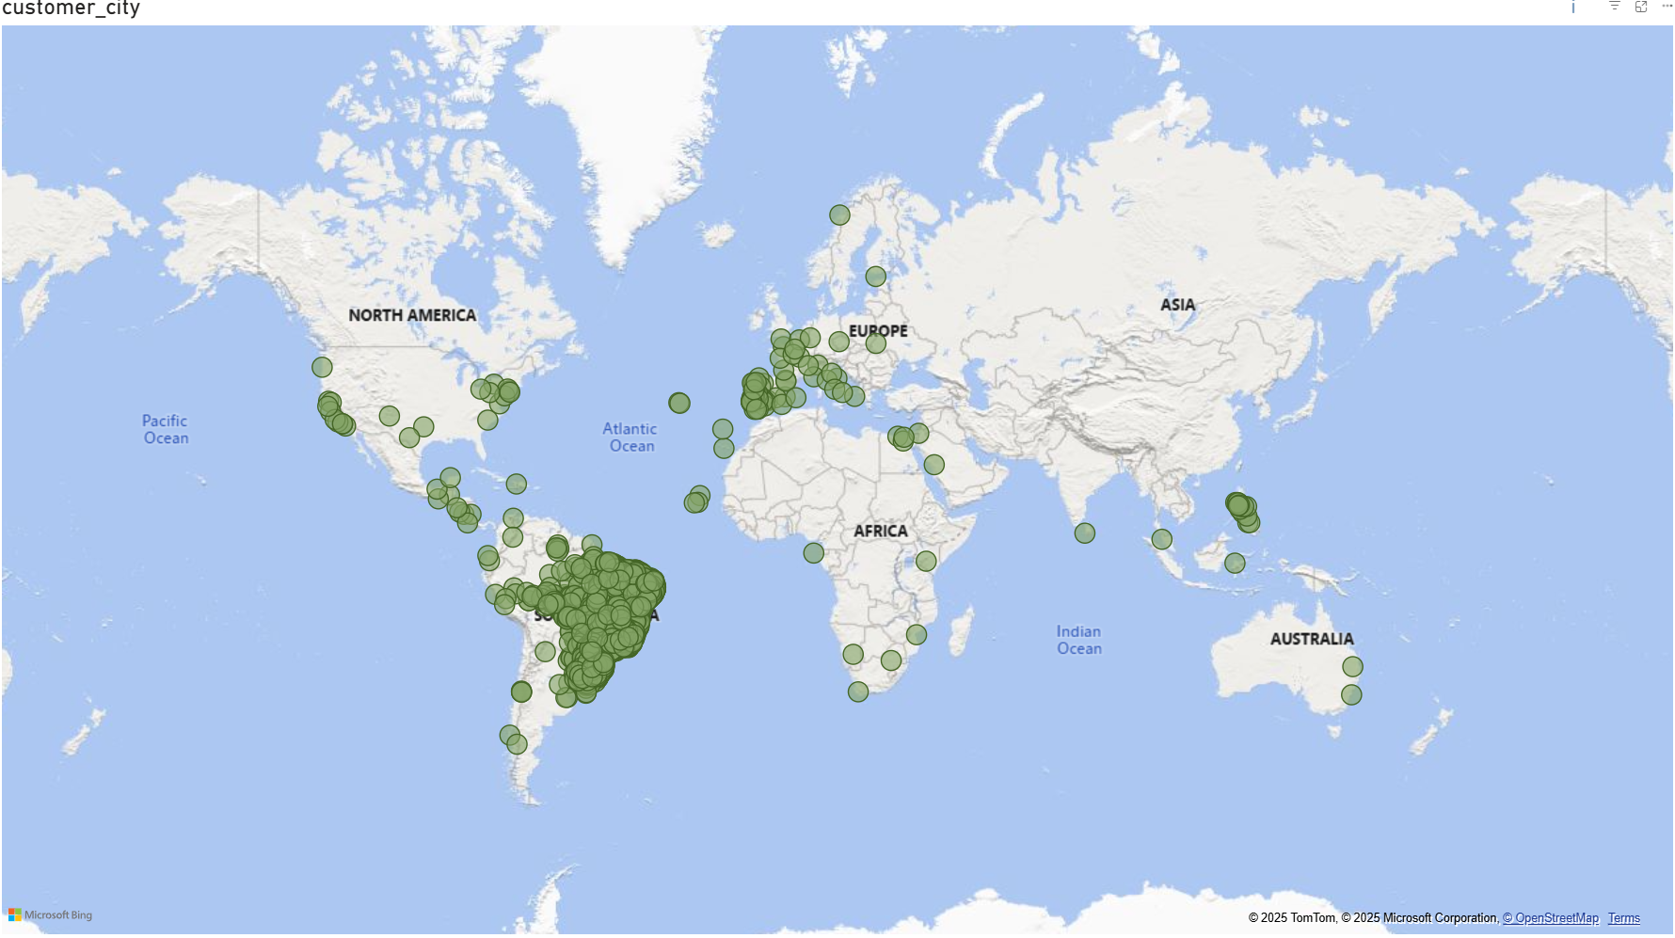
Customer location globally
Globally, it is not surprising that most customers involved in Brazilian commerce are in Brazil.

Slide 22
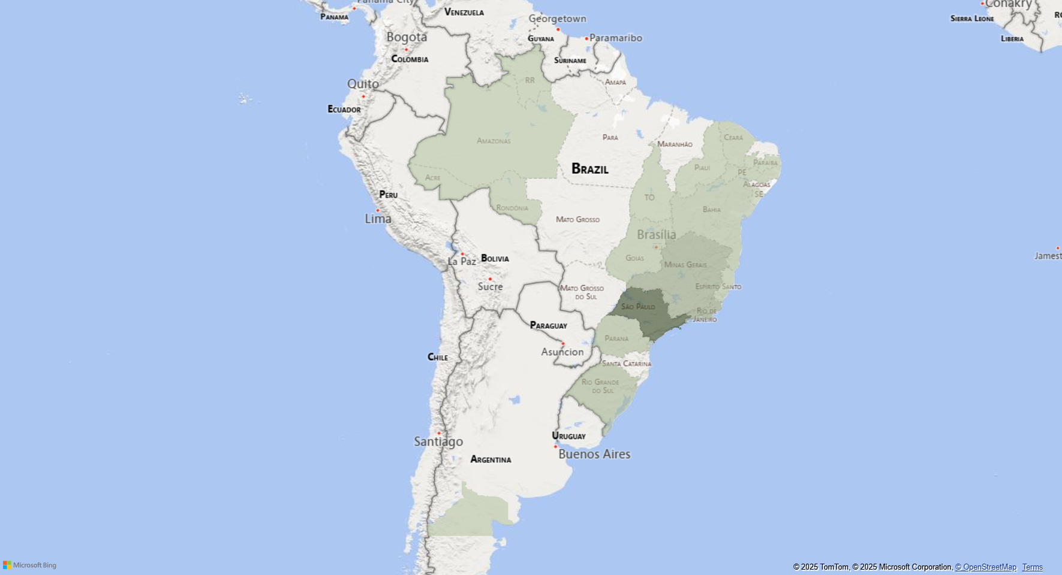
Customer location analysis in Brazil
Deeper analysis of customer locations in Brazil highlighted Sao Paulo (SP) state as having the most customers, with neighboring Rio de Janeiro (RJ) and Minas Gerais (MG) also showing significant numbers, possibly due to SP’s regional influence.
One assumption for this customer concentration is the potential proximity of sellers within these states, although other factors may also play a role.

Slide 23
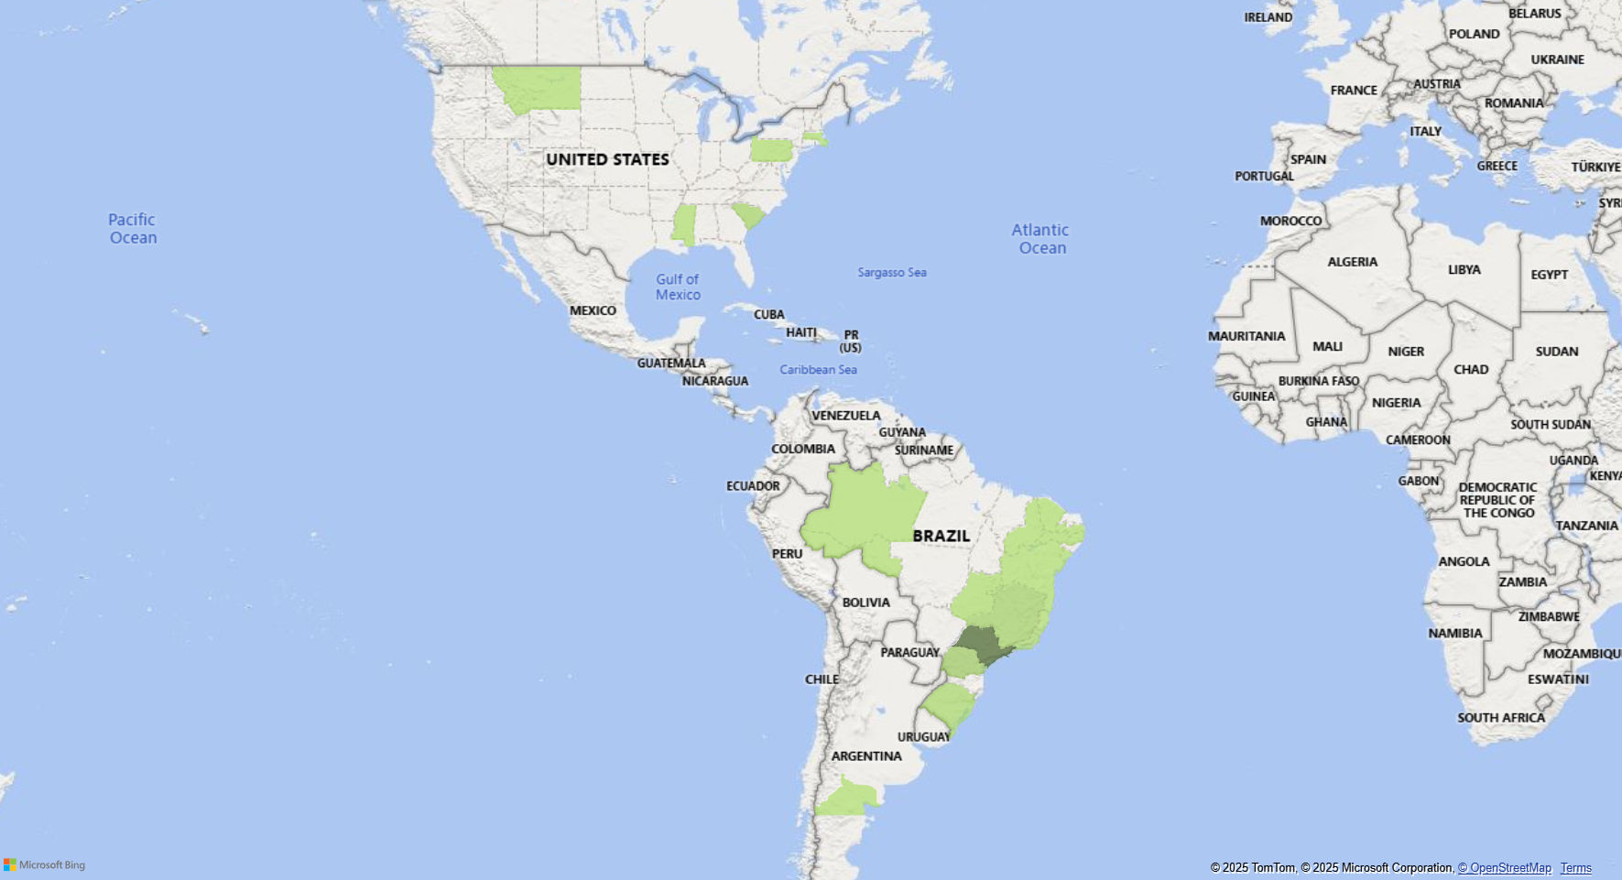
Seller location analysis across America
The analysis confirmed the initial assumption about seller distribution. Despite the presence of some sellers internationally, the majority are located across the main states in Brazil. This is primarily due to the high population density of the three states previously discussed within Brazil.

Slide 24
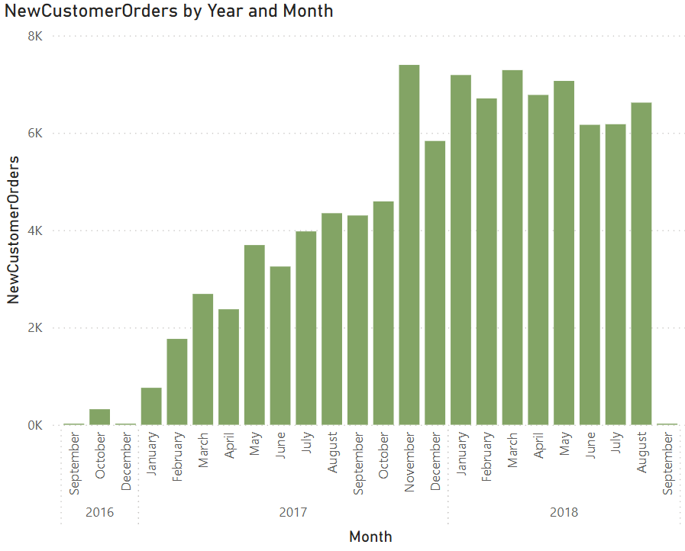
There is significant new customer orders increase from 2017–2018
Given this increase, it might be beneficial to implement a targeted strategy to encourage these new customers to place repeat orders and become long-term customers.
Therefore, a dedicated effort might be required to focus on these new customers to foster repeat business and ensure their retention.
To encourage these new customers to order again and build loyalty, a focused approach may be necessary.

Slide 25
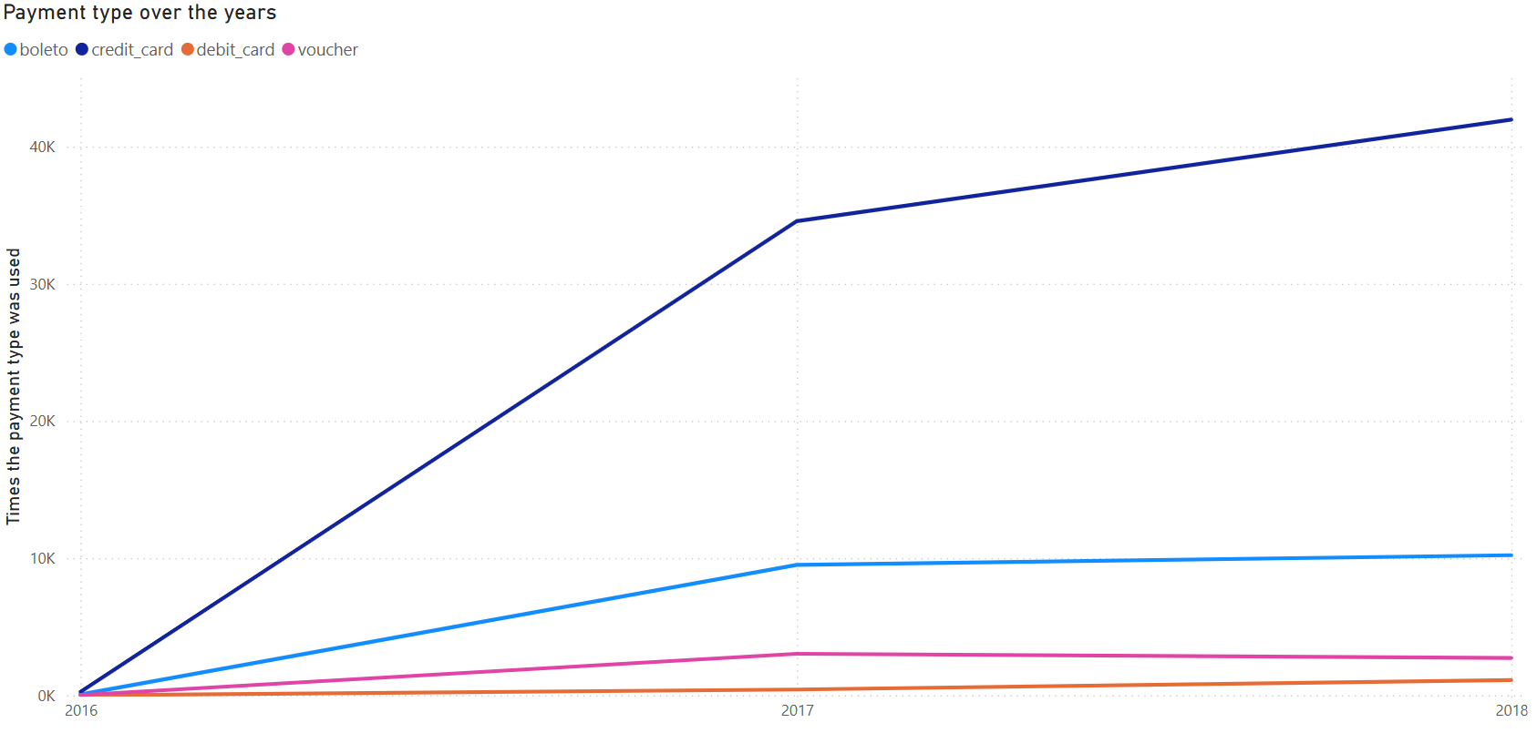
Which payment type does the customers prefer?
This visualization illustrates the different payment methods customers used over time when placing their orders. Notably, there was a significant shift towards credit card usage throughout the years, and this method maintained a strong lead, creating a considerable difference compared to other payment options.

Slide 26
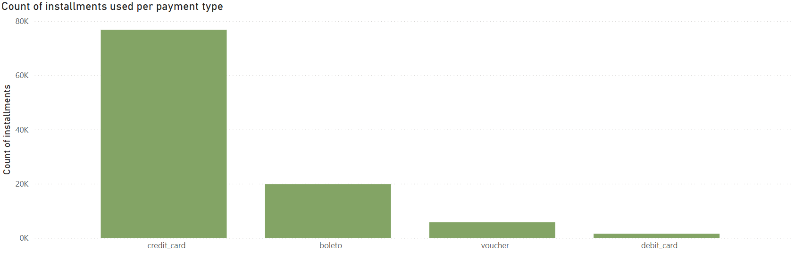
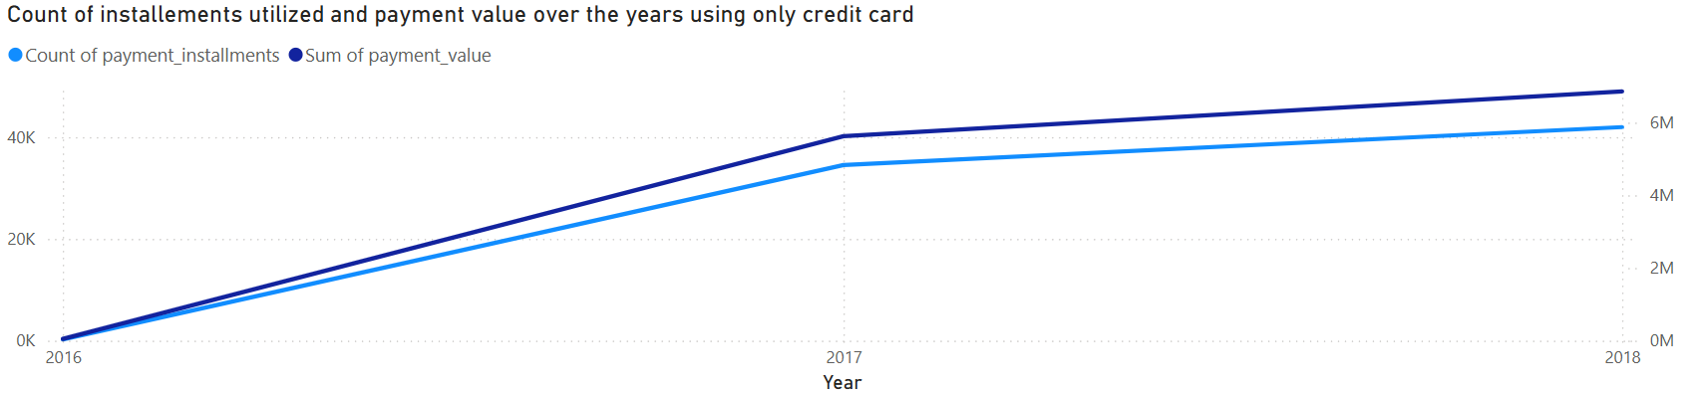
Why?
The chart emphasizes the prevalence of installment usage across payment types, with the graph showcasing the particular strength of credit cards for installment plans. Notably, there is a strong proportional link between the number of installments and the total payment value.
Another key benefit of credit cards is the option for delayed payment.

Slide 27
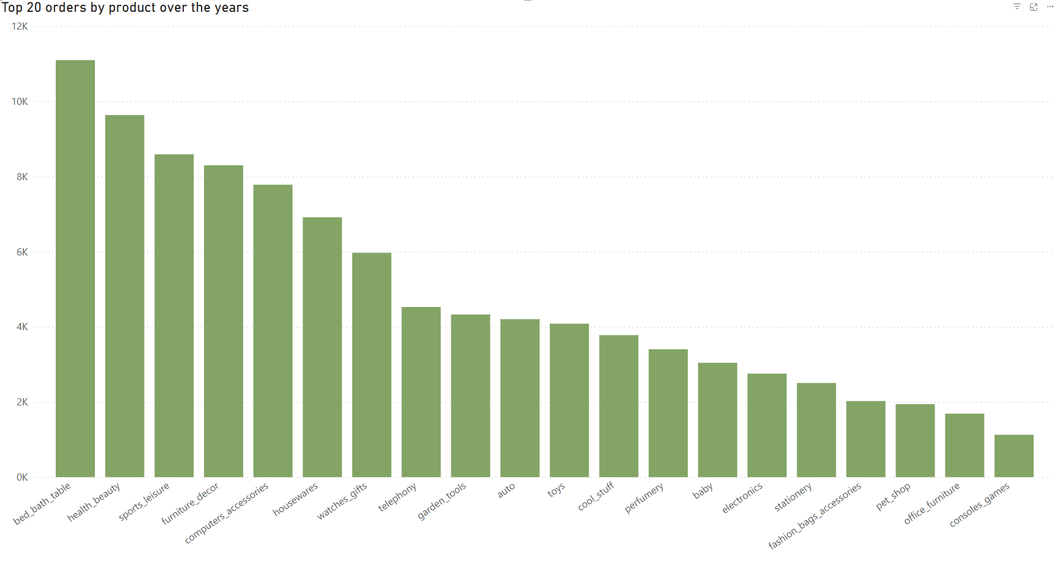
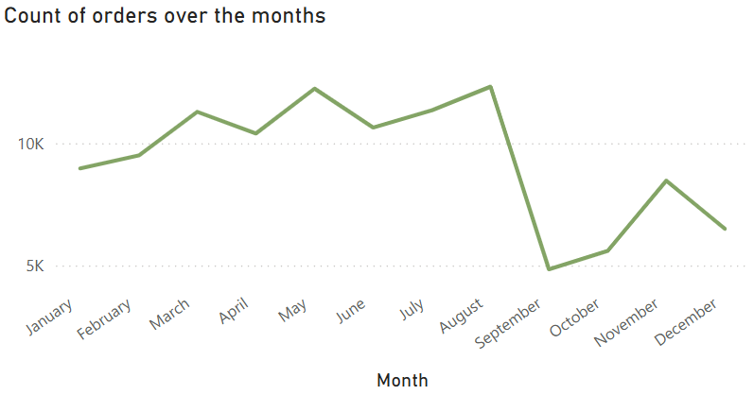
Looking at product categories, the majority of orders, representing 11% of the total, are for items intended for bedrooms, bathrooms, and dining tables.
When examining the purchase patterns in 2017, considering this is the only year where months have the complete months, the first half of the year saw the highest volume of orders.
In contrast, the second half experienced a dip, with September showing the lowest performance.
This low figure for September is likely due to the fact that data collection began and concluded in September of different years (2016 and 2018), leading to a potential bias when observing trends across multiple years.

Slide 28
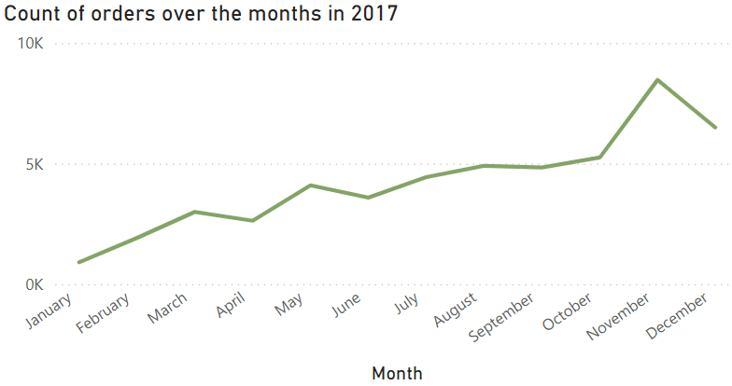
In contrast to the earlier observation, analyzing only the 2017 data indicates that the final quarter of the year was likely the period with the highest customer purchase activity.
This pattern were likely due to the fact of the seasonal events happening during these months. It also happened to be the shortest quarter because of the holidays.

Slide 29
The fact that Q4 had the most orders highlights the significant impact of review scores for online retailers during this peak shopping period.
Looking at the second half of 2017, the marketplace benefited from a high average review score during its busiest months, contributing to an overall average of 4.11.
Although, a significant lower average review score was observed in December.

Slide 30
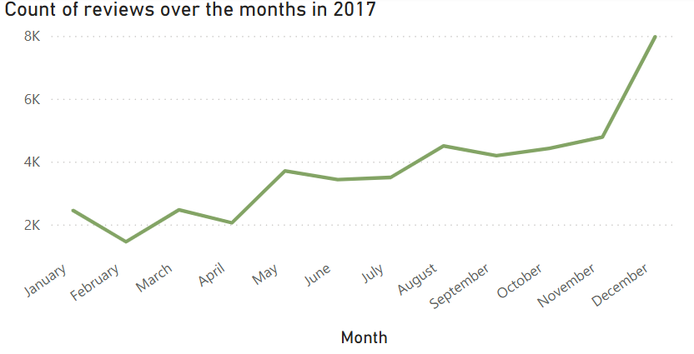
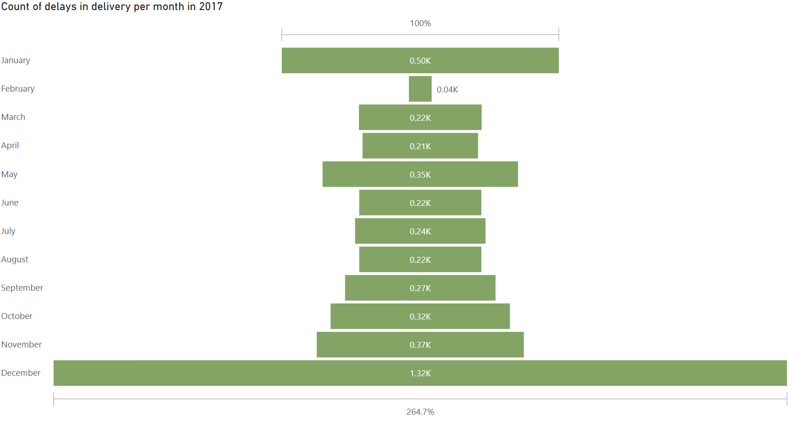
Interestingly, December 2017 also recorded the highest number of reviews received up to that point.
The likely cause for December (and potentially the entire fourth quarter) having the highest volume of reviews coupled with the lowest average score seen so far could be attributed to delivery delays during that period.
This surge in reviews in December is also likely a consequence of the high number of orders placed in November, as illustrated in a previous chart.

Slide 31
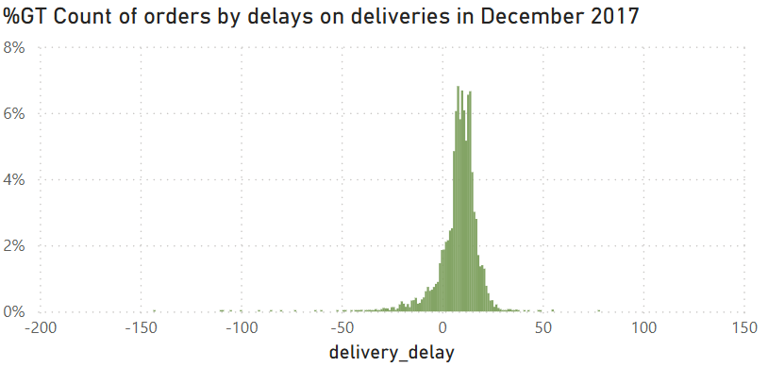
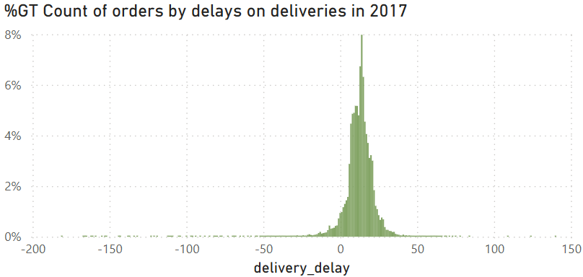
An overview of delivery timeliness in 2017
Positive figures represent deliveries that arrived before the estimated date, and negative figures represent deliveries that were delayed.

Slide 32
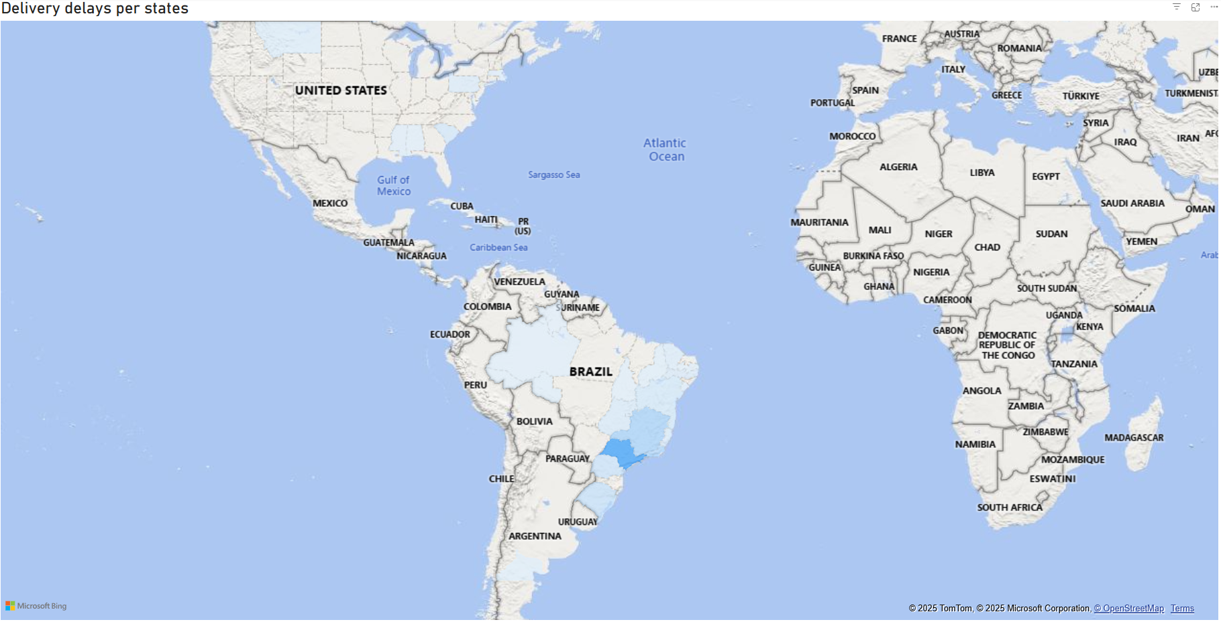
Upon closer examination, it appears that where customers were located was likely not the primary cause of late deliveries.
The purpose of emphasizing this visualization is to propose a connection between the delivery of goods via trucks and the resulting review scores. As seen in previous charts, SP again shows the highest number of delays, which is likely as its high sales volume means more deliveries, and consequently, more potential for delays in that area.

Slide 33
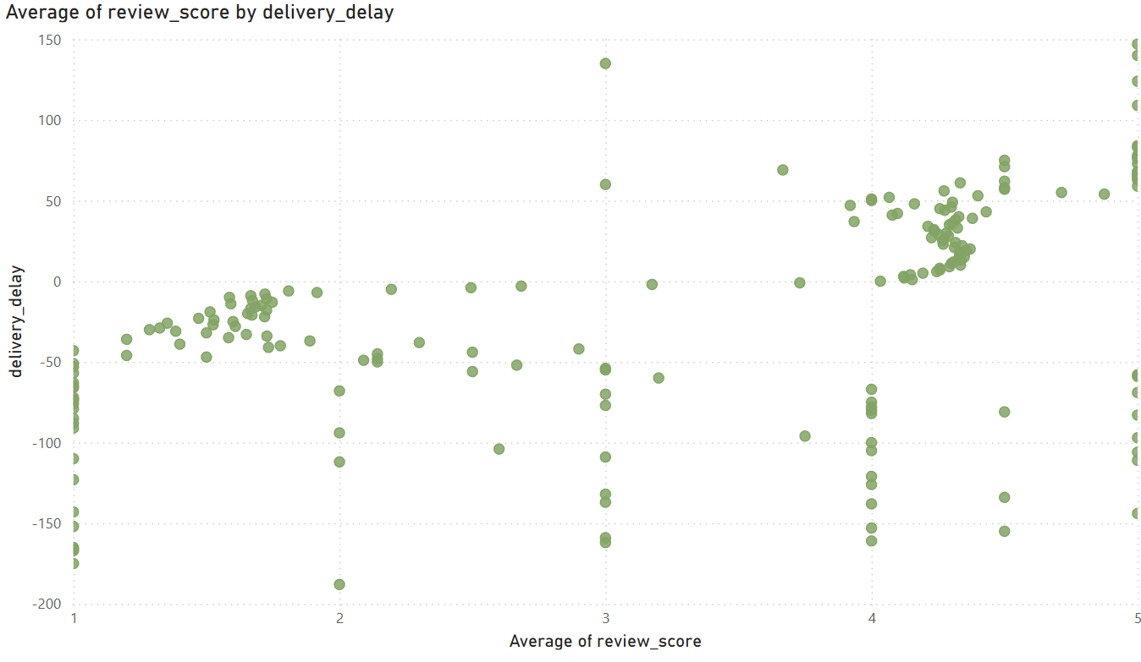
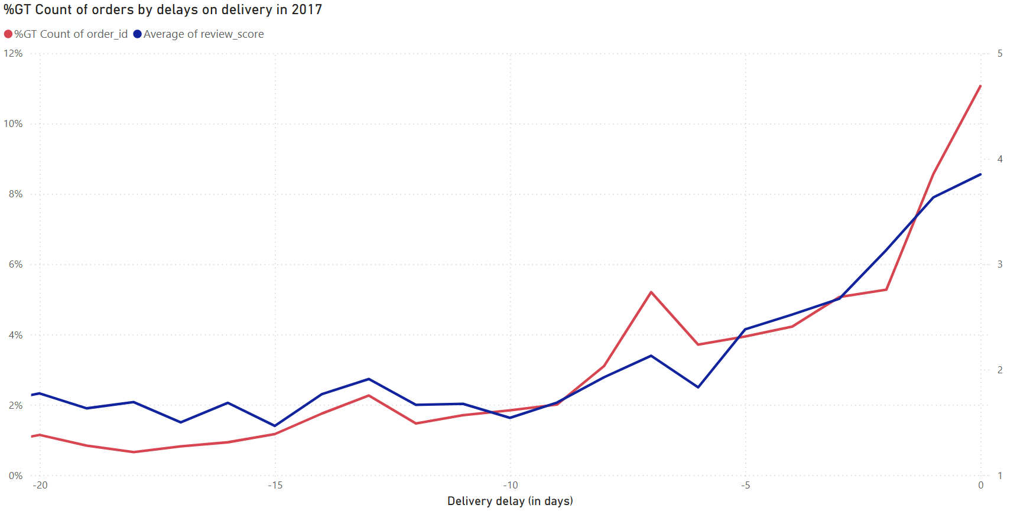
The data suggests a trend where more significant delays in order deliveries lead to poorer customer ratings.

Slide 34
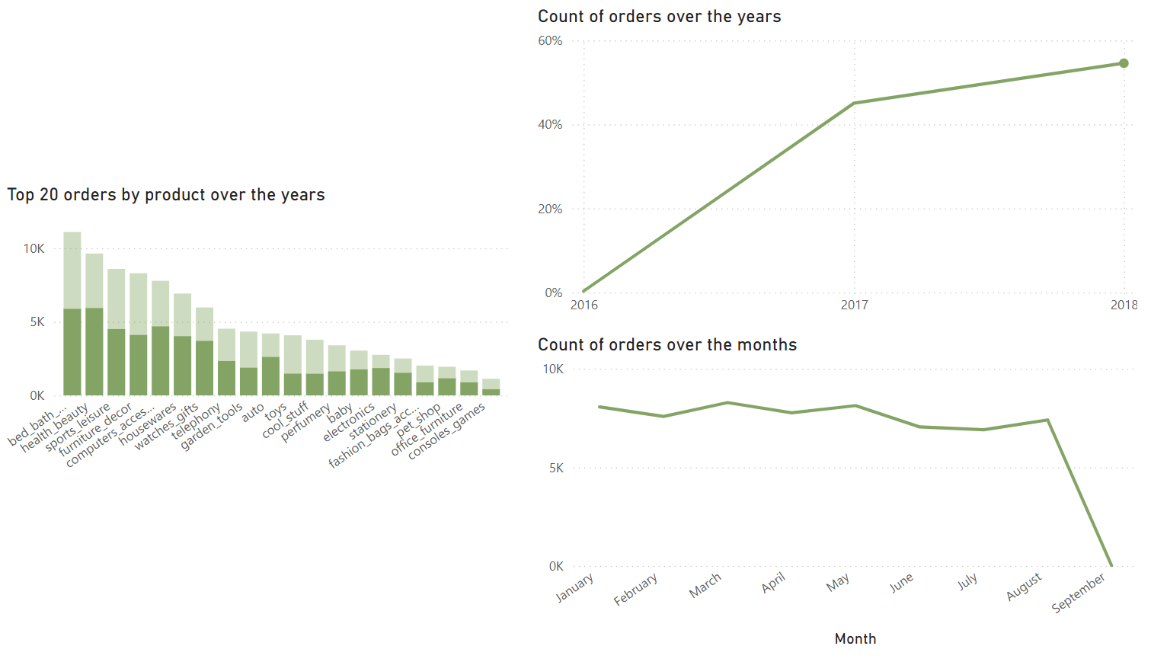
KEY TAKEAWAYS & ACTION POINTS
Olist performed very well on selling orders. For instance, comparison between 2017 and 2018 showcased the increase on sales by 21%, even though only up to September of 2018 was recorded in the dataset.
Drilled through chart for 2018 only.

Slide 35
KEY TAKEAWAYS & ACTION POINTS
Based on the analysis, the data indicates that Brazilian e-commerce activity is highly concentrated in Brazil—particularly in states like São Paulo, Rio de Janeiro, and Minas Gerais—driven by both customer density and seller distribution.
The significant increase in new customer orders from 2017 to 2018 presents a prime opportunity to convert these first-time buyers into repeat customers. To capitalize on this growth, it is recommended to implement targeted retention strategies such as personalized marketing campaigns, loyalty programs, and follow-up incentives to encourage repeat purchases.

Slide 36
KEY TAKEAWAYS & ACTION POINTS
Additionally, since the analysis reveals a strong customer preference for credit card payments—especially when installment options are available—enhancing these payment features could further drive sales. The observed seasonal trends, particularly the dip in performance during September and the delivery delays in Q4 that resulted in lower review scores, suggest that logistics improvements are critical.
Optimizing delivery processes (for example, by leveraging more reliable transportation methods and advanced tracking systems) could alleviate these issues, leading to improved customer satisfaction. These strategic initiatives not only aim to boost retention and customer loyalty but also promise to enhance overall operational efficiency and revenue growth, as corroborated by similar findings across industry analyses online.

Slide 37
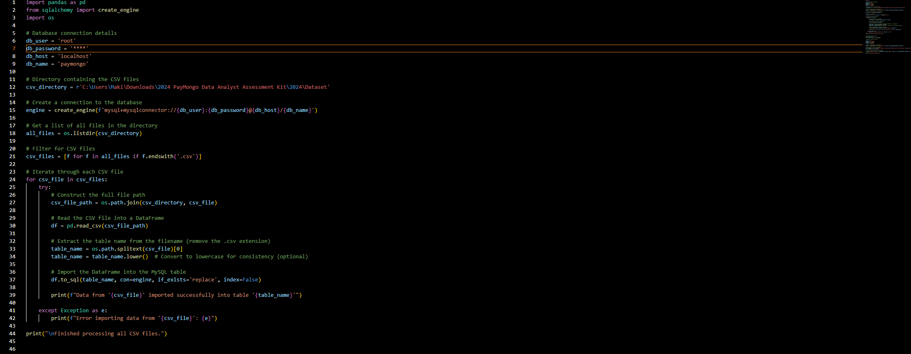
Importing csv files to local SQL database through python script

Slide 38
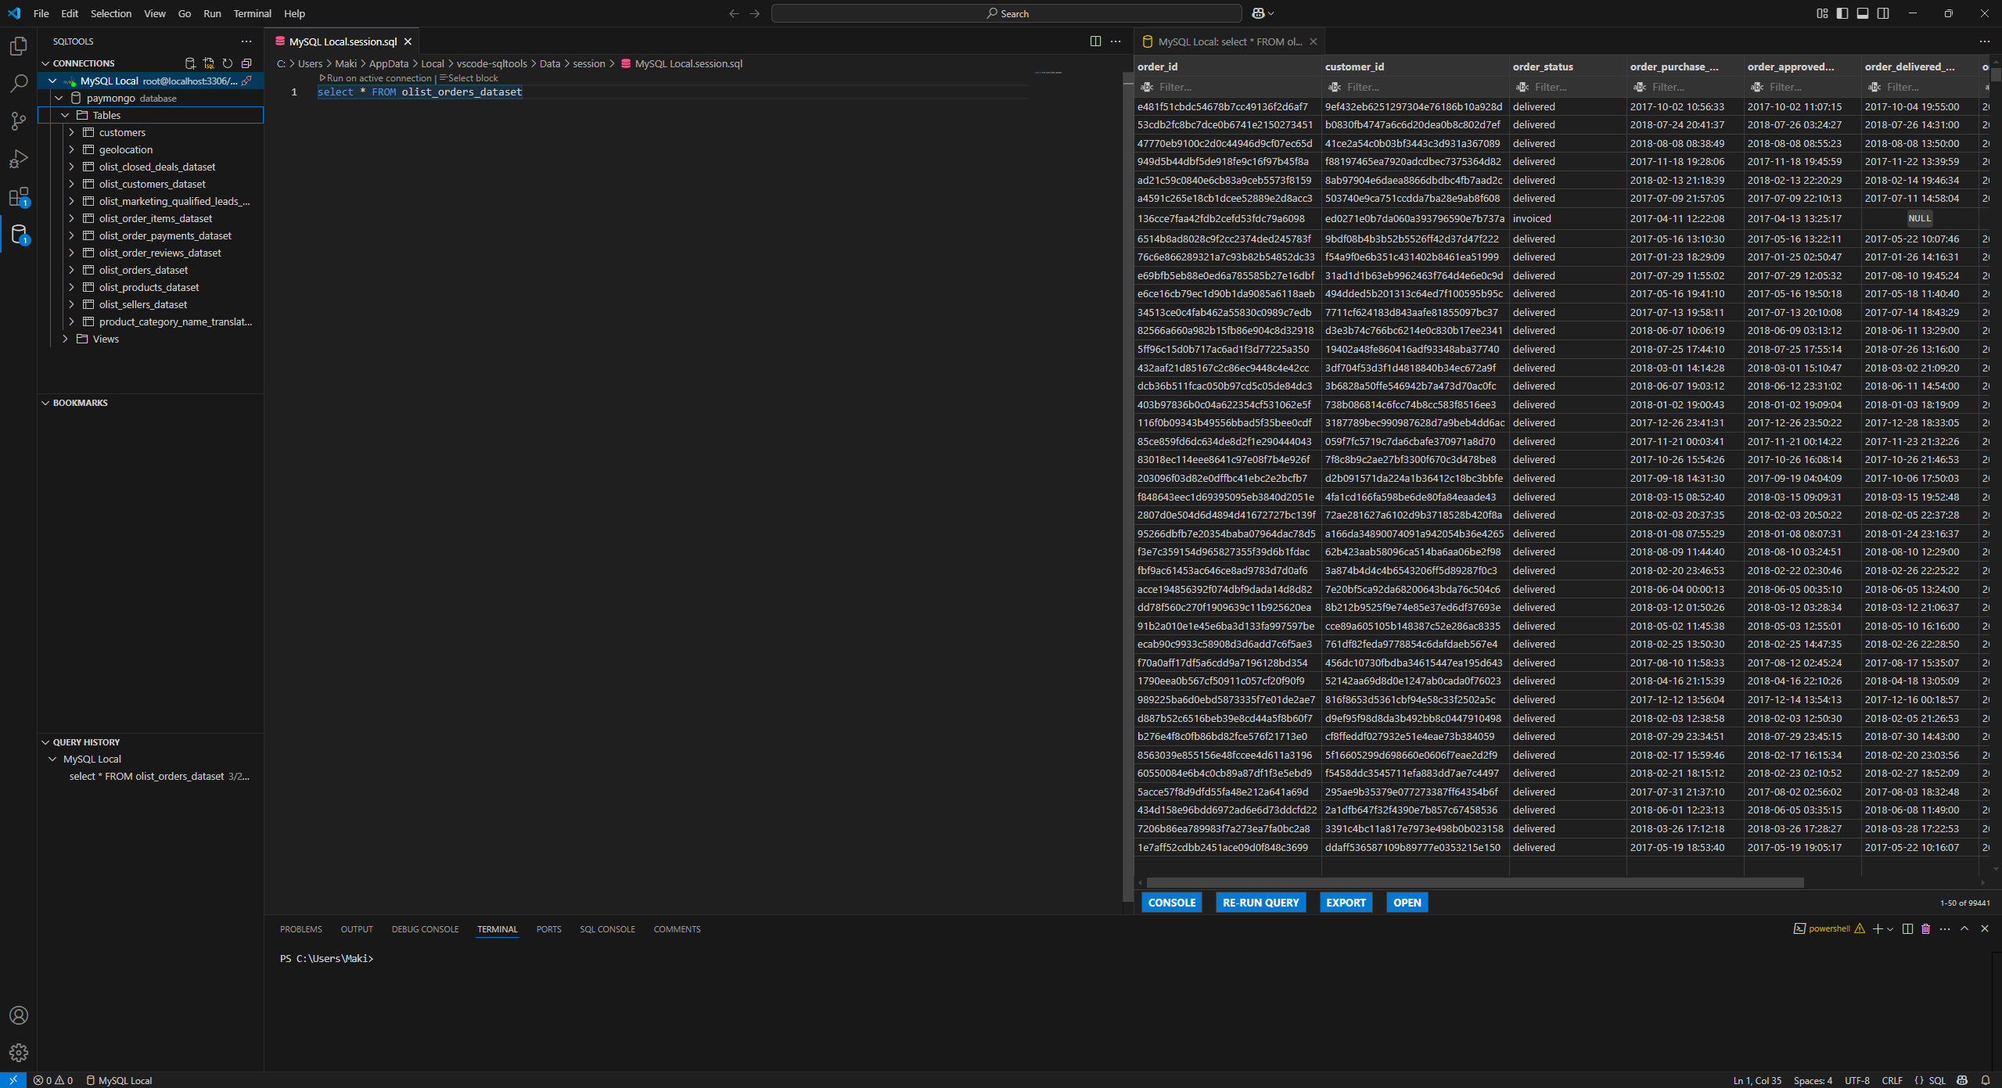
Viewing and exploring all data through local SQL database

Slide 39
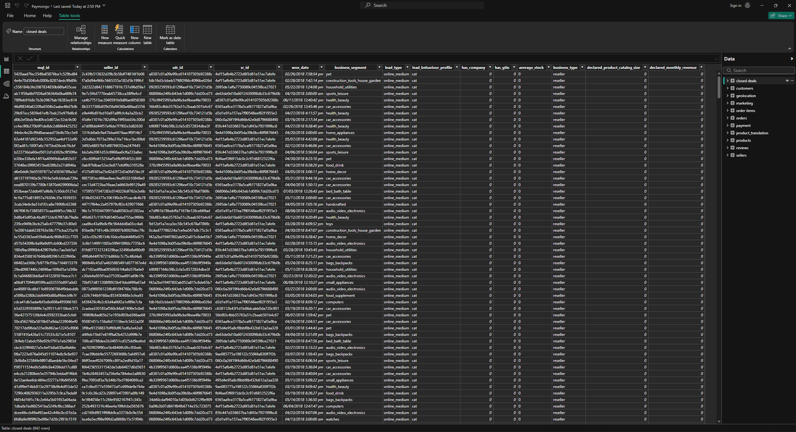
Importing data to Power Bi

Slide 40
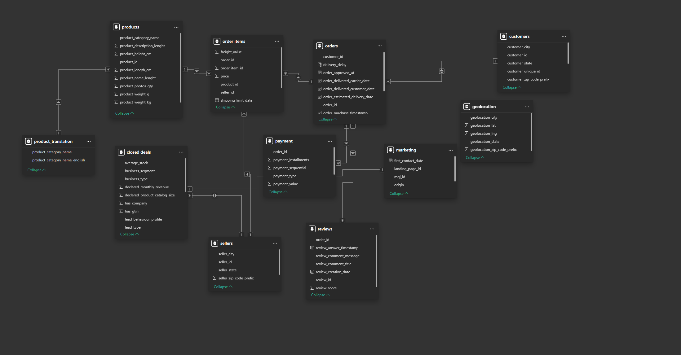
Configuring table relationship in Power Bi based on the given ERD

Slide 41
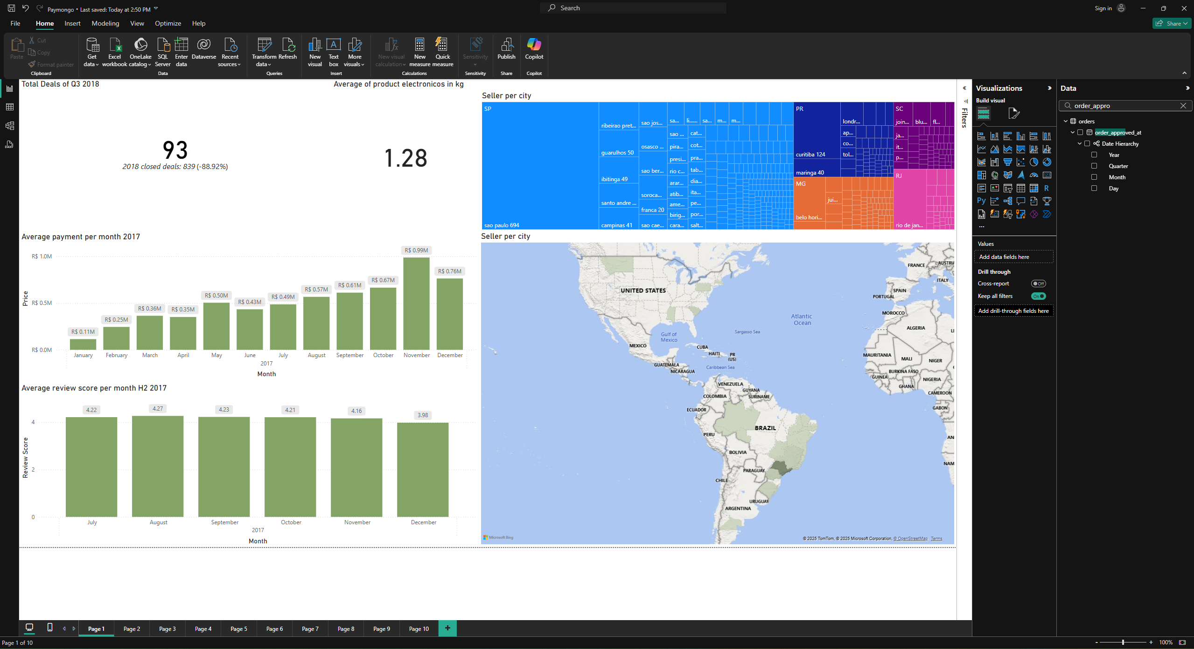
Sample page from Power Bi

